Slide 1
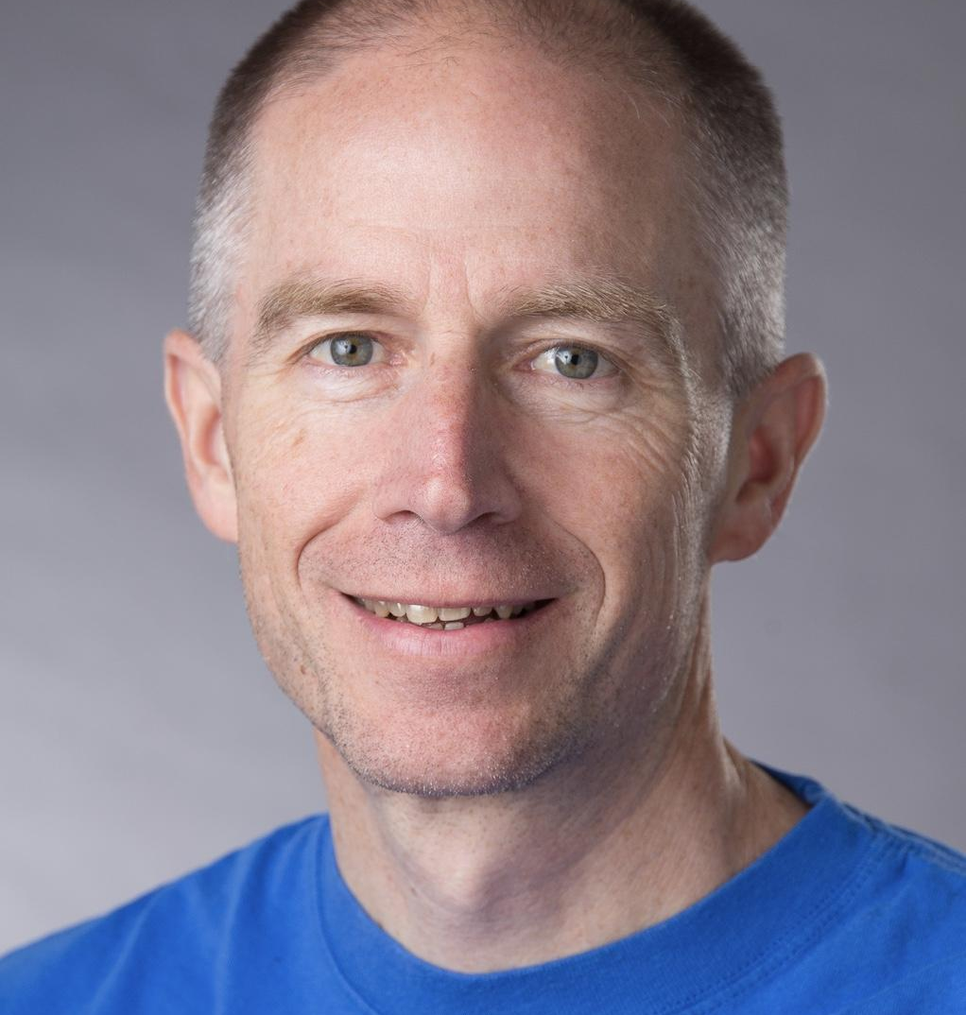
Steve Bement
Retail: Coached leaders and teams at a large US retailer in transforming their development and product management processes. Worked with Product Managers/Owners in redefining the product pipeline, reducing work in progress, and improving collaboration with development. Coached development teams and architects on improving test automation and collaborative development. Initiated Agility Health Radar assessments.
Transportation: Worked with an airline IT organization, coaching teams, business leaders, and managers in adopting Agile. Helped the delivery teams with Agile Engineering practices (Continuous Delivery, Test-driven Development, mob programming) to achieve fully automated, constant delivery to production, with zero defects.
Banking : Coached delivery teams at a credit union, to improve their delivery pipeline, incorporating automated testing into their continuous integration system and transforming the way teams collaborate with QA.
Banking: Coached multiple teams at government financial institution in their Agile transformation. Worked with Scrum Masters, Product Owners, and leadership to successfully deliver a replacement system involving two years of effort.
Telecommunications: Coached multiple teams at US telecom learn Agile Engineering approaches to improve quality and collaboration.
Telecommunications: Helped developers at large telecommunications company in China refactor legacy code to improve design and accommodate change. Helped teams learn unit testing and test-driven development to improve quality in their embedded code (including how to use dual-targeting to break the dependence on hardware).
Utilities: Coached embedded software developers on how to verify their code independent of hardware (same dual-targeting approach as above). Made use of test-driven development in their embedded environment.
Transportation: Worked with development team in developing mobile, high-speed scanning application for tracking shipments. Improved performance of the application and helped in the adoption of better automated testing and build processes.
Steve Bement
Denver, CO
Email: steve.bement@accenture.com
Professional Profile
Steve is a Business Agility Enablement manager within Accenture Business Agility, with a specialization in Agile Software Development coaching.
Steve is an experienced developer and coach, with over 30 years in the software industry. He has practiced Agile and Extreme Programming (XP) for more than 20 years and specializes in helping teams and organizations reach a high-performing state, pushing clean code to production continuously, with zero defects.
Steve has a Master of Software Engineering degree from Seattle University, and numerous certifications from the Scrum Alliance, ICAgile, and Agility Health Radar.
Industry Expertise Functional Expertise
Aerospace
Banking
Health Insurance
Telecommunications
Transportation
Retail
Coaching high-performing teams
Test-driven development
Refactoring
Continuous Delivery
Pair and mob programming
Emergent Design

